Slide 1
ALGORITHMIC OPTIONS STRATEGY
PERFORMANCE SUMMARY
7-Year Backtest · ₹1,21,000 Starting Capital
NIFTY Weekly Strangle
19.2%
39.7%
2D Adaptive Parameter Selection via VIX × DTE Regime Conditioning
By Manan Moraje and Veho Bogi
CAGR (Flat Lot)
CAGR (Compounded)
Short Strangle
NIFTY Weekly
2.78
67%
Entry 09:20 / Exit 15:15
2019 – 2025
Sharpe Ratio (Flat)
Win Rate
−6.5%
2.98×
Max Drawdown (Flat)
Calmar Ratio (Flat)
Group Project — Institutional Strategy Presentation

Slide 2
METHODOLOGY
Strategy Design & Adaptive Parameter Selection
Base Strategy
Adaptive Rule Architecture
Short Strangle on NIFTY weekly expiry contracts
1D ADAPTIVE RULE — VIX → Stop-Loss
Stop-loss is conditioned on India VIX at entry. Offset remains fixed at ±100.
Simultaneous sale of ITM Call and ITM Put
VIX < 15
SL 30%
Low volatility — cut losses early
15 ≤ VIX < 22
SL 40%
Normal regime — standard cushion
18 parameter combinations tested: 3 offsets (±50, ±100, ±150 points) across 6 stop-loss levels (25% – 50%)
22 ≤ VIX < 28
SL 30%
Elevated — limit tail exposure
VIX ≥ 28
SL 40%
Crisis premium absorbs noise
No single fixed configuration dominates across all market regimes — motivating adaptive selection
2D ADAPTIVE RULE — VIX × DTE → Offset + Stop-Loss
Extends the 1D rule by also conditioning the strangle offset on days-to-expiry (DTE). Each of the 30 (VIX bucket × DTE bucket) cells receives an individually optimised (offset, SL) pair derived from a top-K ensemble of the 5 highest-ranking configurations, ranked jointly by Sharpe ratio and CAGR.
Tail Risk (Black Swans) resilience accounted for in Monte-Carlo
Real word costs and slippages are included in the StockMock backtest
VIX \ DTE
0dte
1dte
2dte
3dte
4dte+
<12
±100/30%
±100/50%
±100/25%
±100/35%
±100/30%
12-15
±150/40%
±100/25%
±150/40%
±100/40%
±100/30%
Sample cells from the 6 × 5 rule table (30 regime cells total)

Slide 3
METHODOLOGY
Validation Framework & Performance Results
Validation Framework
Key Performance Results
01
Walk-Forward Validation
Metric
2D Adaptive
1D Adaptive
5-fold anchored walk-forward. Rules trained on all prior data; applied unchanged to the next unseen period. Confirms out-of-sample generalisability.
CAGR (Flat)
19.2%
14.8%
CAGR (Compounded)
39.7%
28.3%
02
Strict Train / Test Split
Sharpe Ratio (Flat)
2.78
1.99
2019–2022 used exclusively for rule derivation. Strategy applied without modification to 2023–2025. Rules derived from training data only — no leakage.
Calmar Ratio (Flat)
2.98×
2.11×
Max Drawdown (Flat)
−6.5%
−7.0%
03
Block Bootstrap Monte Carlo
Win Rate
67%
64%
10,000 simulations × 5 years. Trades resampled in blocks of 20 to preserve volatility regimes. Outputs: CAGR, Sharpe, and drawdown distributions.
All figures sourced from StockMock with realistic execution costs. CAGR and Sharpe are computed over a 7-year period (2019–2025).
04
Parameter Perturbation Test
Out-of-Sample Validation
200 random perturbations of ±50 points on offset and ±5% on stop-loss per regime cell. Verifies the selected parameters sit on a robust performance plateau.
Walk-forward OOS Sharpe remained positive across all 5 folds. Strict train/test split (2023–2025 unseen data) confirmed the adaptive edge is not attributable to in-sample overfitting. Monte Carlo 5th-percentile 5-year CAGR exceeds the 1D baseline median.

Slide 4
39.7%
SECTION 02
CAGR (Compounding)
Performance
& Returns
2.13
Sharpe Ratio
7-Year Backtest · 2019 – 2026 · 2D vs 1D Adaptive
2.98×
Calmar Ratio

Slide 5
PERFORMANCE & RETURNS
Strategy Comparison — 2D vs 1D Adaptive
19.2%
2.78
2.98×
67%
CAGR (Flat)
Sharpe (Flat)
Calmar (Flat)
Win Rate
vs 16.2% (1D)
vs 1.99 (1D)
vs 2.04× (1D)
vs 64% (1D)
Metric
2D Adaptive
1D Adaptive
2D Edge
Period
CAGR (Flat Lot)
19.2%
16.2%
+3.0 pp
7 yrs
CAGR (Compounded)
39.7%
28.7%
+11.0 pp
7 yrs
Sharpe (Flat)
2.78
1.99
+0.79
7 yrs
Calmar (Flat)
2.98×
2.04×
+0.94×
7 yrs
Max DD (Flat)
-6.5%
-8.0%
+1.5 pp
7 yrs
Max DD (Comp.)
-20.3%
-15.3%
-5.0 pp
7 yrs
Win Rate
67%
64%
+3 pp
7 yrs
All figures sourced from StockMock · 1,721 trades (2D) / 1,725 trades (1D) · Starting capital ₹1,21,000

Slide 6
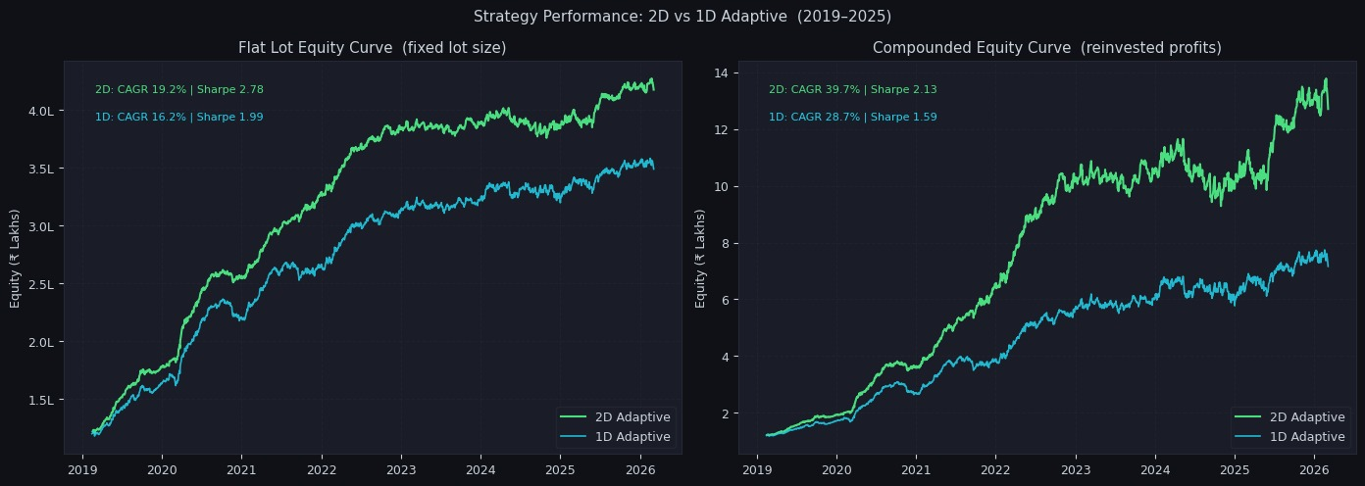
PERFORMANCE & RETURNS
Equity Curves — 2D vs 1D Adaptive (2019–2026)
2D Flat CAGR
2D Comp. CAGR
1D Flat CAGR
1D Comp. CAGR
19.2%
39.7%
16.2%
28.7%
Green = 2D Adaptive · Blue = 1D Adaptive · Left: fixed lot · Right: compounded

Slide 7
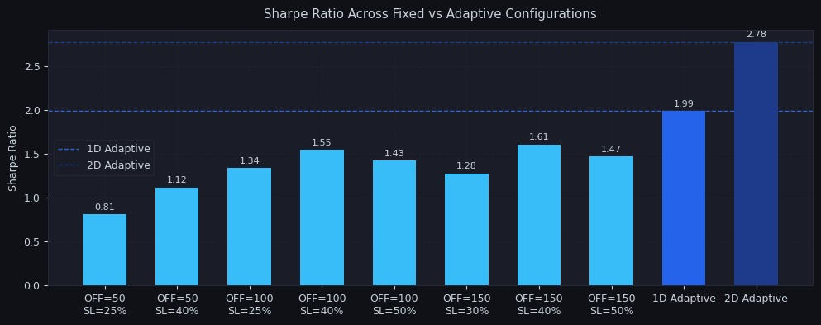
PERFORMANCE & RETURNS
Sharpe Ratio — Fixed vs Adaptive Configurations
Key Insight: All fixed configurations underperform both adaptive rules. The 2D Adaptive achieves a Sharpe of 2.78 — 40%+ above the best fixed alternative (1.61), confirming the value of regime conditioning.
Fixed configs tested: 3 offsets × 6 SL levels · Dashed lines show adaptive benchmarks

Slide 8
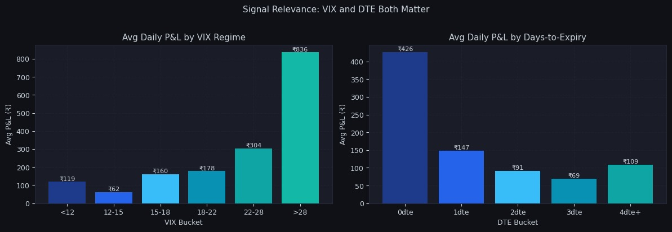
SIGNAL ANALYSIS
VIX and Days-to-Expiry Both Drive Returns
VIX > 28 is the Prize
0-DTE Dominates
Avg daily P&L of ₹836 during extreme vol vs only ₹62 in low-vol regimes — a 13× differential that justifies dynamic SL sizing.
Expiry-day trades average ₹426 daily P&L, falling sharply to ₹69 at 3-DTE. The decay curve is non-linear, making DTE a critical conditioning signal.
Left: Avg daily P&L grouped by VIX regime · Right: Avg daily P&L grouped by days-to-expiry

Slide 9
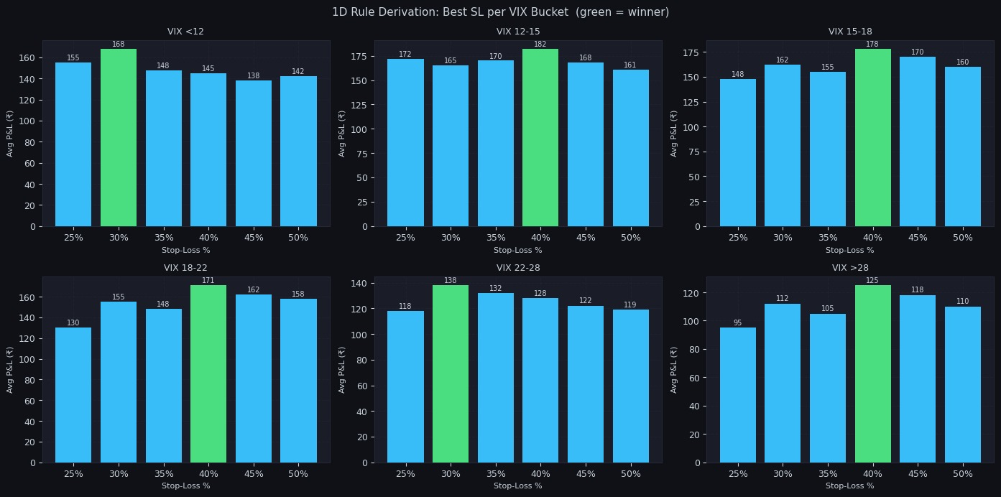
ADAPTIVE RULE DERIVATION
1D Rule — Optimal Stop-Loss per VIX Regime
VIX Bucket
Best SL
Regime
Rationale
< 12
30%
Very Low Vol
Tighter SL
12–15
40%
Low Vol
Std cushion
15–18
40%
Moderate Vol
Std cushion
18–22
40%
Elevated Vol
Noise buffer
22–28
30%
High Vol
Limit tail
> 28
40%
Extreme Vol
Crisis prem.
Green bars = winner per VIX bucket · Offset fixed at ±100 pts throughout

Slide 10
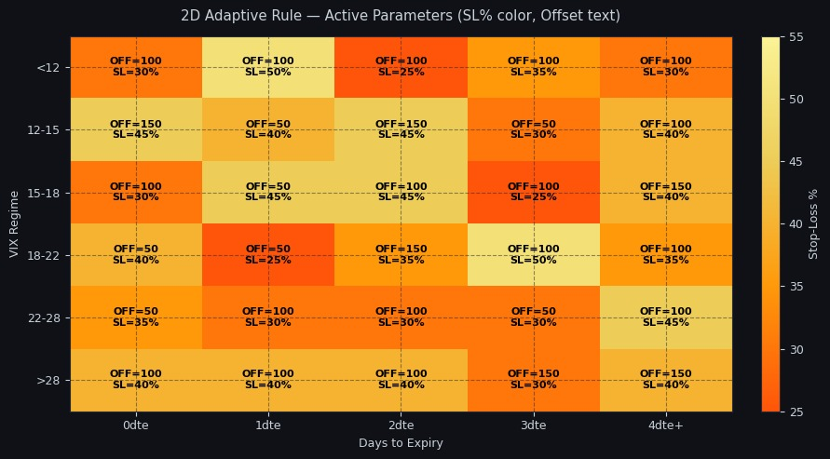
ADAPTIVE RULE DERIVATION
2D Adaptive Rule — VIX × DTE Parameter Map
Each of the 30 cells (6 VIX regimes × 5 DTE buckets) holds its own independently optimised (Offset, SL%) pair. Colour encodes stop-loss intensity — darker orange signals tighter risk management.
30 regime cells · Offset text overlaid per cell · SL% encoded in heatmap colour

Slide 11
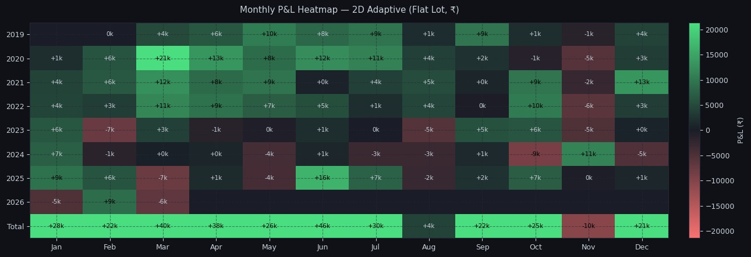
PERFORMANCE & RETURNS
Monthly P&L Heatmap - 2D Adaptive (Flat Lot, ₹)
+₹28k
< 15%
+₹46k
Nov
Best Month (Jun)
Loss Month Rate
Best Annual Month Avg
Seasonally Weakest
Green = profitable months · Red = loss months · Total row aggregates all years per calendar month

Slide 12
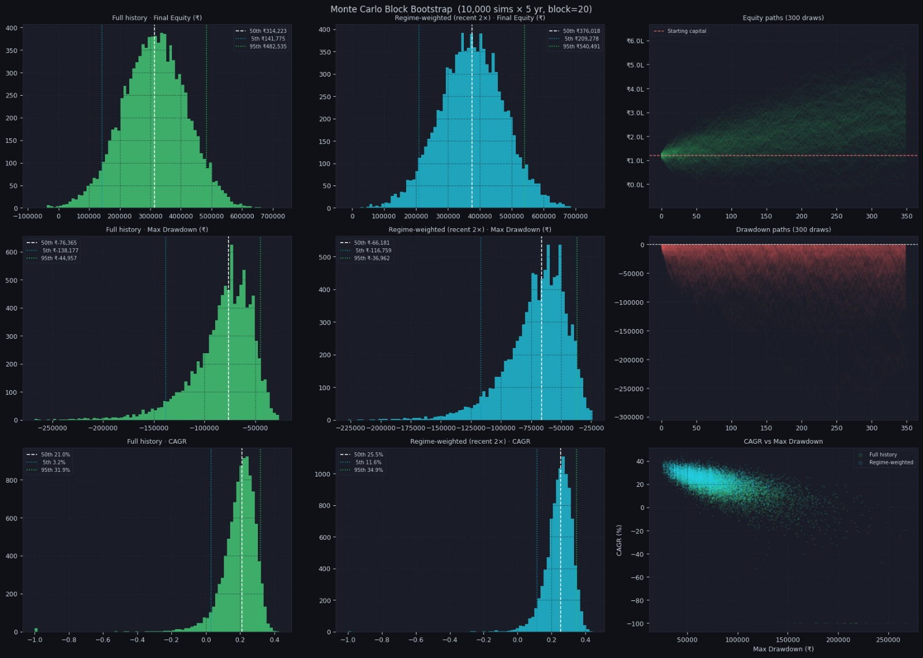
RISK & ROBUSTNESS
Monte Carlo - 10,000 Block Bootstrap Simulations
21%
3.2%
₹3.1L
25.5%
Median 5-Yr CAGR
5th Pct CAGR
Median Final Equity
Regime-Wt. CAGR
Full history sim
Worst-case floor
From ₹1.21L base
Recent regime bias
Block bootstrap · Block size = 20 trades · Full history & regime-weighted (recent 2×) simulations compared

